Slide 1
c++ 模板
高级语言程序设计

Slide 2
CONTEN TS
概念
设计目的
示例

Slide 3
概念
/ 01
definition

Slide 4
概念
Templates are a feature of the C++ programming language that allows functions and classes to operate with generic types. This allows a function or class to work on many different data types without being rewritten for each one.
Templates are of great utility to programmers in C++, especially when combined with multiple inheritance and operator overloading. The C++ Standard Library provides many useful functions within a framework of connected templates.
-from wikipedia
source code reuse
generic types
abstraction

Slide 5
概念
多态
泛型编程（generic programming）是C++支持的另一种编程模式。它与OOP的目标相同，即使重用代码和抽象通用概念的技术更简单。不过OOP强调的是编程的数据方面，而泛型编程强调的是独立于特定数据类型。它们的侧重点不同。OOP是一个管理大型项目的工具，而泛型编程提供了执行常见任务（如对数据排序或合并链表）的工具。术语泛型（generic）指的是创建独立于类型的代码。C++的数据表示有多种类型——整数、小数、字符、字符串、用户定义的、由多种类型组成的复合结构。例如，要对不同类型的数据进行排序，通常必须为每种类型创建一个排序函数。泛型编程需要对语言进行扩展，以便可以只编写一个泛型（即不是特定类型的）函数，并将其用于各种实际类型。C++模板提供了完成这种任务的机制。
-来自C++Primer
OOP
C++
封装
继承

Slide 6
设计目的
/ 02
purpose of using template

Slide 7
设计目的
Now a problem arises. You have an IntStack class, which holds integers.But you want a stack that holds shapes or aircraft or plants or something else. Reinventing your source code every time doesn’t seem like a very intelligent approach with a language that touts reusability. There must be a better way.There are three techniques for source code reuse in this situation:the C way, ; the Smalltalk approach,which significantly affected C++; and the C++ approach: templates.
- from thinking in c++ vol one
C
Smalltalk
C++
copy the source code for a Stack and make modifications by hand, introducing new errors in the process
inherit generic base class Object and multiple inheritance
It's painful to use
use a code-substitution device called a template.The container no longer holds a generic base class called Object, but instead it holds an unspecified parameter. When you use a template, the parameter is substituted by the compiler.

Slide 8
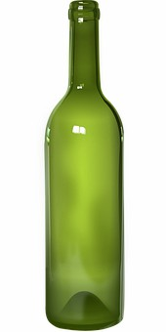
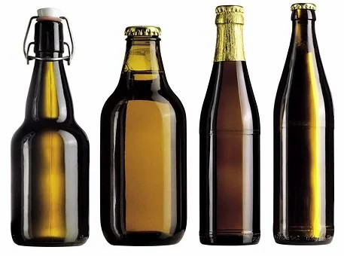
设计目的
实现了参数化的容器类
T container
int
char
udt…

Slide 9
设计目的
关于STL

Slide 10
设计目的
The Standard Template Library (STL) is a software library for the C++ programming language that influenced many parts of the C++ Standard Library. It provides four components called algorithms, containers, and iterators.
The STL achieves its results through the use of templates.
Four ideas of STL:generic programming, abstractness without loss of efficiency, the Von Neumann computation model,[2] and value semantics

Slide 11
设计目的
standard template library
Containers
Iterators
Algorithms
A container class describes an object that holds other objects.
perform operations on a data structure while knowing as little as possible about that structure, thus producing data structure independence.
The STL algorithms provide a vocabulary with which to describe solutions.

Slide 12
示例
/ 03
examples

Slide 13
示例
语法
函数模板
类模板
template <typename type>
ret-type func-name(param list)
{
// code
}
template <class type>
class class-name
{
//code
}

Slide 14
示例
类模板
#include <iostream>
using namespace std;
//定义模板
template<class T, int size = 10>
class Array {
T A[size];
public:
T& operator[](int index) {
return A[index];
}
};
int main() {
Array<int> ia; //int替换
Array<char> ca; //char替换
for (int i = 0; i < 10; i++) {
ia[i] = i;
ca[i] = 65+i;
}
for (int j = 0; j < 10; j++) {
cout << ia[j] << " " << ca[j] << endl;
}
return 0;
}

Slide 15
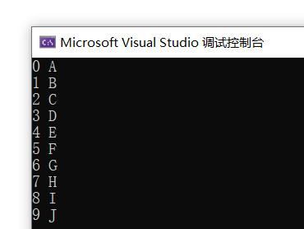
示例
运行结果：

Slide 16
示例
函数模板
#include <iostream>
using namespace std;
template<typename T>
T max(T &a,T &b){
if (a <= b)
return b;
else return a;
};
int main() {
int a = 3;
int b = 5;
string s1 = "asd";
string s2 = "qwe";
cout << max(a, b) << endl;
cout << max(s1, s2) << endl;
return 0;
}

Slide 17
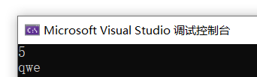
示例
运行结果：

Slide 18
示例
继承模板
template<typename M,typename N>
class Son: public Father<M,N> {
public:
M sa;
N sb;
public:
Son(M d,N i) :Father<M, N>(d,i){
sa = d;
sb = i;
}
};
int main() {
Son<double, int> s(3,4);
cout << s.sa << endl;
cout << s.get() << endl;;
return 0;
}
#include <iostream>
using namespace std;
template<typename T, typename K>
class Father {
T fa;
K fb;
public:
Father(T t,K k){
fa = t;
fb = k;
}
K get() {
return fb;
}
};

Slide 19
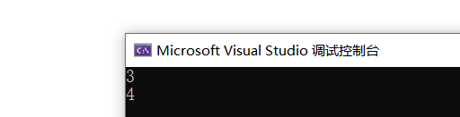
示例
运行结果：

Slide 20
示例
多态模板
#include <iostream>
using namespace std;
template<typename T, typename K>
class Father {
public:
virtual void fun() {}
};
template<typename M,typename N,typename P>
class Son: public Father<M,N> {
public:
void fun() {
cout << "son-fun" << endl;
}
};
int main() {
Father<int, double>* p = new Son<int, double, char>;
p->fun();
delete p;
return 0;
}

Slide 21
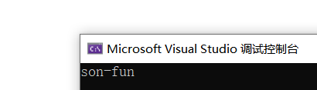
示例
运行结果：

Slide 22
示例
显式具体化
有时传入参数为结构体类型，进行操作时就有限制，无法选择结构体中的具体成员，此时进行显式具体化，当编译器找到与函数调用匹配的具体化定义时，将使用该定义，而不再寻找模板。
//无模板函数
void Max(strT &,strT &)
//模板函数
template<typename T>
void Max(T &,T &);
//显式具体化
template<>void Max<strT>( strT &,strT &);
int main() {
int a;
int b;
...
cout<<Max(a,b)<<endl;
strT s1;
strT s2;
cout<<Max(s1,s2)<<endl;
}

Slide 23
示例
非模板版本>显式具体化>模板版本

Slide 24
示例
具体化和实例化
隐式实例化、显式实例化和显式具体化统称为具体化，它们表示的都是使用具体类型的函数定义，而不是通用描述
template <class T>
void Swap(T &,T &);//模板类型
template <> void Swap<strT>(strT &, strT &);//显式具体化
int main(void){
template void Swap<char>(char &, char &);//显式实例化
short a,b;
...
Swap(a,b)//隐式模板实例化
strT m,n;
...
Swao(m,n);//显式具体化
char g,h;
...
Swap(g,h);//显式模板实例化
}

Slide 25
Thanks

